Slide 1
Chapter 4
Further development and analysis of the classical linear regression model
‘Introductory Econometrics for Finance’ © Chris Brooks 2019

Slide 2

Generalising the Simple Model to
Multiple Linear Regression
Before, we have used the model
t = 1,2,...,T
But what if our dependent (y) variable depends on more than one independent variable?
For example the number of cars sold might plausibly depend on
1. the price of cars
2. the price of public transport
3. the price of petrol
4. the extent of the public’s concern about global warming
Similarly, stock returns might depend on several factors.
Having just one independent variable is no good in this case - we want to have more than one x variable. It is very easy to generalise the simple model to one with k-1 regressors (independent variables).
‘Introductory Econometrics for Finance’ © Chris Brooks 2019

Slide 3

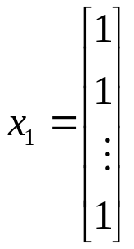
Multiple Regression and the Constant Term
Now we write
, t=1,2,...,T
Where is x₁? It is the constant term. In fact the constant term is usually represented by a column of ones of length T:
β₁ is the coefficient attached to the constant term (which we called α before).
‘Introductory Econometrics for Finance’ © Chris Brooks 2019

Slide 4
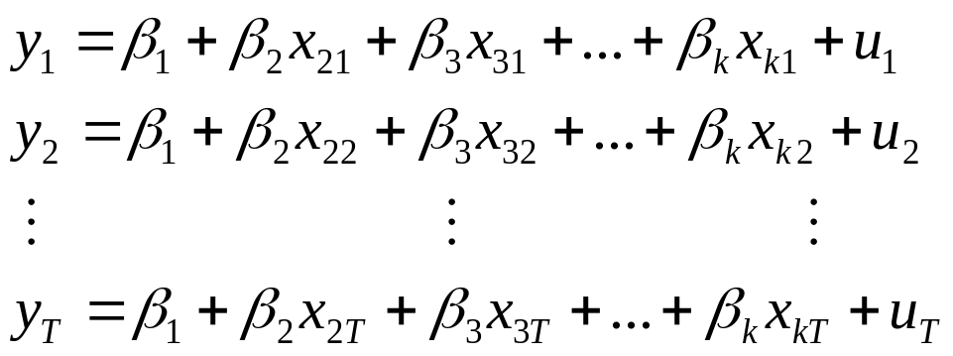
Different Ways of Expressing the Multiple Linear Regression Model
We could write out a separate equation for every value of t:
We can write this in matrix form
y = Xβ +u
where y is T × 1
X is T × k
β is k × 1
u is T × 1
‘Introductory Econometrics for Finance’ © Chris Brooks 2019

Slide 5
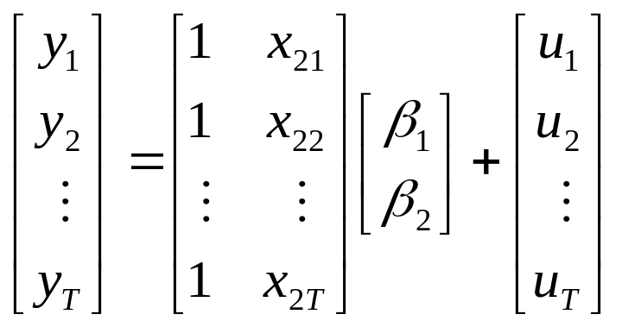
Inside the Matrices of the
Multiple Linear Regression Model
e.g. if k is 2, we have 2 regressors, one of which is a column of ones:
T ×1 T×2 2×1 T×1
Notice that the matrices written in this way are conformable.
‘Introductory Econometrics for Finance’ © Chris Brooks 2019

Slide 6
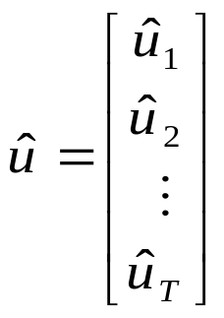
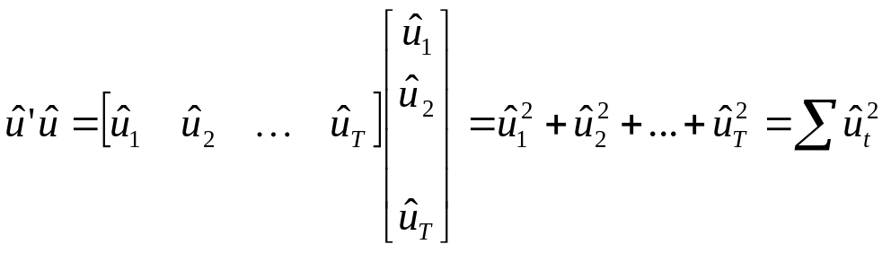
How Do We Calculate the Parameters (the β ) in this Generalised Case?
Previously, we took the residual sum of squares, and minimised it w.r.t. α and β.
In the matrix notation, we have
The RSS would be given by
‘Introductory Econometrics for Finance’ © Chris Brooks 2019

Slide 7
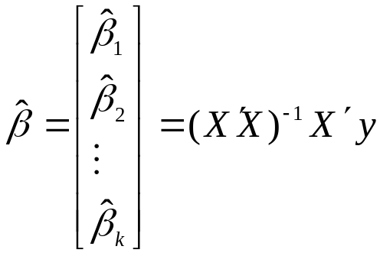
The OLS Estimator for the
Multiple Regression Model
In order to obtain the parameter estimates, β₁, β₂,..., β_{k}, we would minimise the RSS with respect to all the βs.
It can be shown that
‘Introductory Econometrics for Finance’ © Chris Brooks 2019

Slide 8

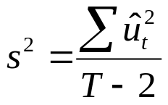
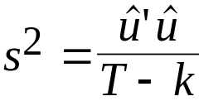




Calculating the Standard Errors for the
Multiple Regression Model
Check the dimensions: is k × 1 as required.
But how do we calculate the standard errors of the coefficient estimates?
Previously, to estimate the variance of the errors, σ², we used .
Now using the matrix notation, we use
where k = number of regressors. It can be proved that the OLS estimator of the variance of is given by the diagonal elements of , so that the variance of is the first element, the variance of is the second element, and …, and the variance of is the k^{th} diagonal element.
‘Introductory Econometrics for Finance’ © Chris Brooks 2019

Slide 9

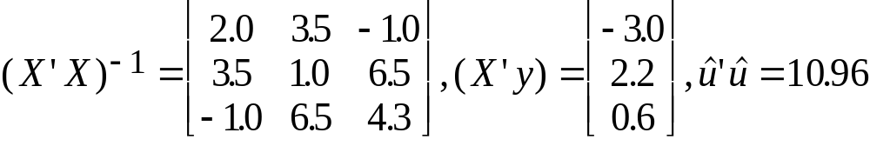

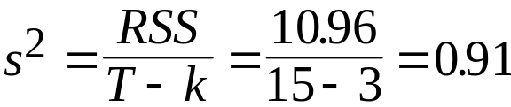
Calculating Parameter and Standard Error Estimates for Multiple Regression Models: An Example
Example: The following model with k=3 is estimated over 15 observations:
and the following data have been calculated from the original X’s.
Calculate the coefficient estimates and their standard errors.
To calculate the coefficients, just multiply the matrix by the vector to obtain
.
To calculate the standard errors, we need an estimate of σ².
‘Introductory Econometrics for Finance’ © Chris Brooks 2019

Slide 10

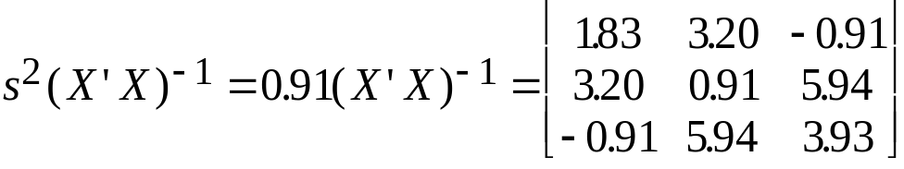
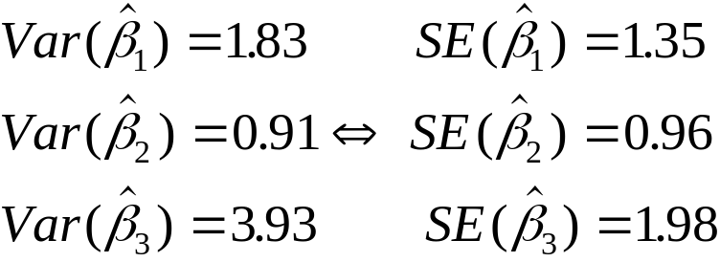
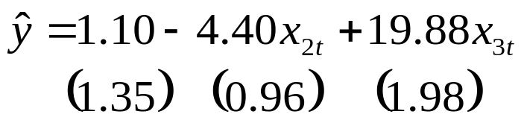
Calculating Parameter and Standard Error Estimates for Multiple Regression Models: An Example (cont’d)
The variance-covariance matrix of is given by
The variances are on the leading diagonal:
We write:
‘Introductory Econometrics for Finance’ © Chris Brooks 2019

Slide 11
Testing Multiple Hypotheses: The F-test
We used the t-test to test single hypotheses, i.e. hypotheses involving only one coefficient. But what if we want to test more than one coefficient simultaneously?
We do this using the F-test. The F-test involves estimating 2 regressions.
The unrestricted regression is the one in which the coefficients are freely determined by the data, as we have done before.
The restricted regression is the one in which the coefficients are restricted, i.e. the restrictions are imposed on some βs.
‘Introductory Econometrics for Finance’ © Chris Brooks 2019

Slide 12
The F-test:
Restricted and Unrestricted Regressions
Example
The general regression is
y_{t} = β₁ + β₂x_{2t} + β₃x_{3t} + β₄x_{4t} + u_{t} (1)
We want to test the restriction that β₃+β₄ = 1 (we have some hypothesis from theory which suggests that this would be an interesting hypothesis to study). The unrestricted regression is (1) above, but what is the restricted regression?
y_{t} = β₁ + β₂x_{2t} + β₃x_{3t} + β₄x_{4t} + u_{t} s.t. β₃+β₄ = 1
We substitute the restriction (β₃+β₄ = 1) into the regression so that it is automatically imposed on the data
β₃+β₄ = 1 ⇒ β₄ = 1- β₃
‘Introductory Econometrics for Finance’ © Chris Brooks 2019

Slide 13
The F-test: Forming the Restricted Regression
y_{t} = β₁ + β₂x_{2t} + β₃x_{3t} + (1-β₃)x_{4t} + u_{t}
y_{t} = β₁ + β₂x_{2t} + β₃x_{3t} + x_{4t} - β₃x_{4t} + u_{t}
Gather terms in β’s together and rearrange
(y_{t} - x_{4t}) = β₁ + β₂x_{2t} + β₃(x_{3t} - x_{4t}) + u_{t}
This is the restricted regression. We actually estimate it by creating two new variables, call them, say, P_{t} and Q_{t}
P_{t} = y_{t} - x_{4t}
Q_{t} = x_{3t} - x_{4t} so
P_{t} = β₁ + β₂x_{2t} + β₃Q_{t} + u_{t} is the restricted regression we actually estimate.
‘Introductory Econometrics for Finance’ © Chris Brooks 2019

Slide 14
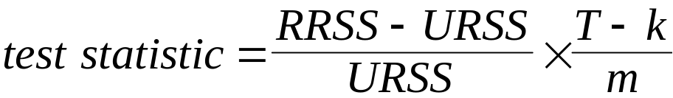
Calculating the F-test Statistic
The test statistic is given by
where URSS = RSS from unrestricted regression
RRSS = RSS from restricted regression
m = number of restrictions
T = number of observations
k = number of regressors in unrestricted regression including a constant in the unrestricted regression (or the total number of parameters to be estimated).
‘Introductory Econometrics for Finance’ © Chris Brooks 2019

Slide 15
The F-distribution
The test statistic follows the F-distribution, which has 2 d.f. parameters.
The value of the degrees of freedom parameters are m and (T-k) respectively (the order of the d.f. parameters is important).
The appropriate critical value will be in column m, row (T-k).
The F-distribution has only positive values and is not symmetrical. We therefore only reject the null if the test statistic > critical F-value.
‘Introductory Econometrics for Finance’ © Chris Brooks 2019

Slide 16
Determining the Number of Restrictions in an F-test
Examples :
H₀: hypothesis No. of restrictions, m
β₁ + β₂ = 2 1
β₂ = 1 and β₃ = -1 2
β₂ = 0, β₃ = 0 and β₄ = 0 3
If the model is y_{t} = β₁ + β₂x_{2t} + β₃x_{3t} + β₄x_{4t} + u_{t},
then the null hypothesis
H₀: β₂ = 0, and β₃ = 0 and β₄ = 0 is tested by the regression F-statistic. It tests the null hypothesis that all of the coefficients except the intercept coefficient are zero.
Note the form of the alternative hypothesis for all tests when more than one restriction is involved: H₁: β₂ ≠ 0, or β₃ ≠ 0 or β₄ ≠ 0
‘Introductory Econometrics for Finance’ © Chris Brooks 2019

Slide 17
What we Cannot Test with Either an F or a t-test
We cannot test using this framework hypotheses which are not linear
or which are multiplicative, e.g.
H₀: β₂ β₃ = 2 or H₀: β₂ ² = 1
cannot be tested.
‘Introductory Econometrics for Finance’ © Chris Brooks 2019

Slide 18
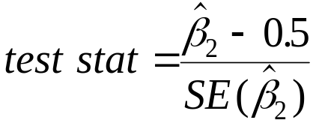
The Relationship between the t and the F-Distributions
Any hypothesis which could be tested with a t-test could have been tested using an F-test, but not the other way around.
For example, consider the hypothesis
H₀: β₂ = 0.5
H₁: β₂ ≠ 0.5
We could have tested this using the usual t-test:
or it could be tested in the framework above for the F-test.
Note that the two tests always give the same result since the t-distribution is just a special case of the F-distribution.
For example, if we have some random variable Z, and Z ∼ t (T-k) then also Z² ∼ F(1,T-k)
‘Introductory Econometrics for Finance’ © Chris Brooks 2019

Slide 19
F-test Example
Question: Suppose a researcher wants to test whether the returns on a company stock (y) show unit sensitivity to two factors (factor x₂ and factor x₃) among three considered. The regression is carried out on 144 monthly observations. The regression is y_{t} = β₁ + β₂x_{2t} + β₃x_{3t} + β₄x_{4t}+ u_{t}
- What are the restricted and unrestricted regressions?
- If the two RSS are 436.1 and 397.2 respectively, perform the test.
Solution:
Unit sensitivity implies H₀:β₂=1 and β₃=1. The unrestricted regression is the one in the question. The restricted regression is (y_{t}-x_{2t}-x_{3t})= β₁+ β₄x_{4t}+u_{t} or letting
z_{t}=y_{t}-x_{2t}-x_{3t}, the restricted regression is z_{t}= β₁+ β₄x_{4t}+u_{t}
In the F-test formula, T=144, k=4, m=2, RRSS=436.1, URSS=397.2
F-test statistic = 6.68. Critical value is an F(2,140) = 3.07 (5%) and 4.79 (1%).
Conclusion: Reject H₀.
‘Introductory Econometrics for Finance’ © Chris Brooks 2019

Slide 20
Data Mining
Data mining is searching many series for statistical relationships without theoretical justification.
For example, suppose we generate one dependent variable and twenty explanatory variables completely randomly and independently of each other.
If we regress the dependent variable separately on each independent variable, on average one slope coefficient will be significant at 5%.
If data mining occurs, the true significance level will be greater than the nominal significance level.
‘Introductory Econometrics for Finance’ © Chris Brooks 2019

Slide 21


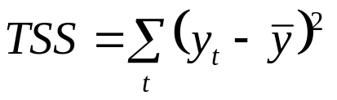
Goodness of Fit Statistics
We would like some measure of how well our regression model actually fits the data.
We have goodness of fit statistics to test this: i.e. how well the sample regression function (srf) fits the data.
The most common goodness of fit statistic is known as R². One way to define R² is to say that it is the square of the correlation coefficient between y and .
For another explanation, recall that what we are interested in doing is explaining the variability of y about its mean value, , i.e. the total sum of squares, TSS:
We can split the TSS into two parts, the part which we have explained (known as the explained sum of squares, ESS) and the part which we did not explain using the model (the RSS).
‘Introductory Econometrics for Finance’ © Chris Brooks 2019

Slide 22
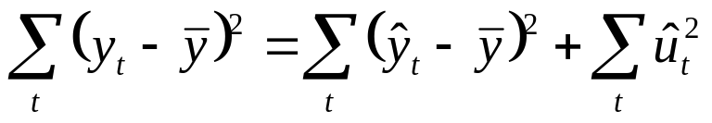
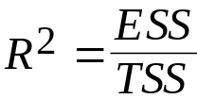
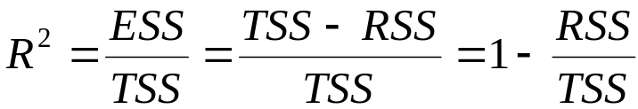
Defining R²
That is, TSS = ESS + RSS
Our goodness of fit statistic is
But since TSS = ESS + RSS, we can also write
R² must always lie between zero and one. To understand this, consider two extremes
RSS = TSS i.e. ESS = 0 so R² = ESS/TSS = 0
ESS = TSS i.e. RSS = 0 so R² = ESS/TSS = 1
‘Introductory Econometrics for Finance’ © Chris Brooks 2019

Slide 23
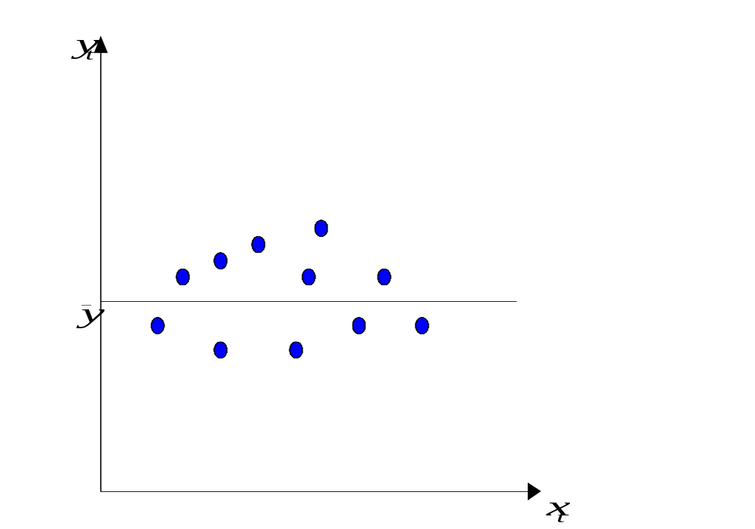
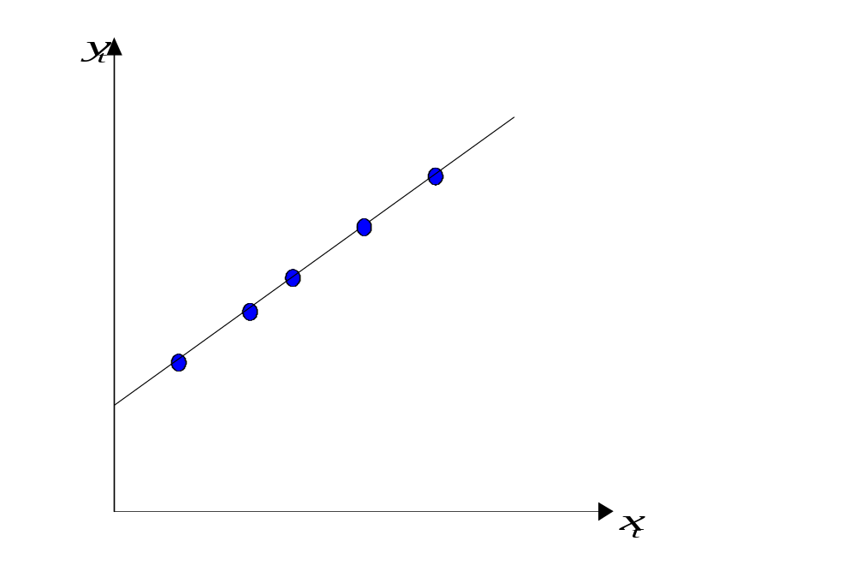
The Limit Cases: R² = 0 and R² = 1
‘Introductory Econometrics for Finance’ © Chris Brooks 2019

Slide 24
Problems with R² as a Goodness of Fit Measure
There are a number of them:
1. R² is defined in terms of variation about the mean of y so that if a model is reparameterised (rearranged) and the dependent variable changes, R² will change.
2. R² never falls if more regressors are added. to the regression, e.g. consider:
Regression 1: y_{t} = β₁ + β₂x_{2t} + β₃x_{3t} + u_{t}
Regression 2: y = β₁ + β₂x_{2t} + β₃x_{3t} + β₄x_{4t} + u_{t}
R² will always be at least as high for regression 2 relative to regression 1.
3. R² quite often takes on values of 0.9 or higher for time series regressions.
‘Introductory Econometrics for Finance’ © Chris Brooks 2019

Slide 25

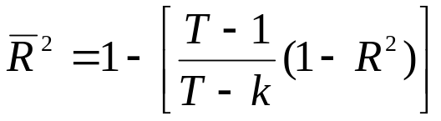
Adjusted R²
In order to get around these problems, a modification is often made which takes into account the loss of degrees of freedom associated with adding extra variables. This is known as , or adjusted R^{2:}
So if we add an extra regressor, k increases and unless R² increases by a more than offsetting amount, will actually fall.
There are still problems with the criterion:
1. A “soft” rule
    2. No distribution for or R²
‘Introductory Econometrics for Finance’ © Chris Brooks 2019

Slide 26
A Regression Example:
Hedonic House Pricing Models
Hedonic models are used to value real assets, especially housing, and view the asset as representing a bundle of characteristics.
Des Rosiers and Thérialt (1996) consider the effect of various amenities on rental values for buildings and apartments 5 sub-markets in the Quebec area of Canada.
The rental value in Canadian Dollars per month (the dependent variable) is a function of 9 to 14 variables (depending on the area under consideration). The paper employs 1990 data, and for the Quebec City region, there are 13,378 observations, and the 12 explanatory variables are:
LnAGE - log of the apparent age of the property
NBROOMS - number of bedrooms
AREABYRM - area per room (in square metres)
ELEVATOR - a dummy variable = 1 if the building has an elevator; 0 otherwise
BASEMENT - a dummy variable = 1 if the unit is located in a basement; 0 otherwise
‘Introductory Econometrics for Finance’ © Chris Brooks 2019

Slide 27
Hedonic House Pricing Models:
Variable Definitions
OUTPARK - number of outdoor parking spaces
INDPARK - number of indoor parking spaces
NOLEASE - a dummy variable = 1 if the unit has no lease attached to it; 0 otherwise
LnDISTCBD - log of the distance in kilometres to the central business district
SINGLPAR - percentage of single parent families in the area where the building stands
DSHOPCNTR- distance in kilometres to the nearest shopping centre
VACDIFF1 - vacancy difference between the building and the census figure
Examine the signs and sizes of the coefficients.
  The coefficient estimates themselves show the Canadian dollar rental price per month of each feature of the dwelling.
‘Introductory Econometrics for Finance’ © Chris Brooks 2019

Slide 28
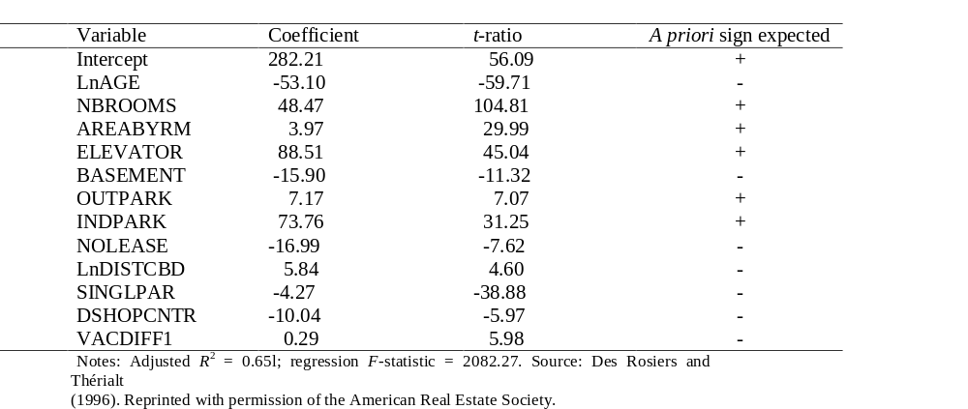
Hedonic House Price Results
Dependent Variable: Canadian Dollars per Month
‘Introductory Econometrics for Finance’ © Chris Brooks 2019

Slide 29
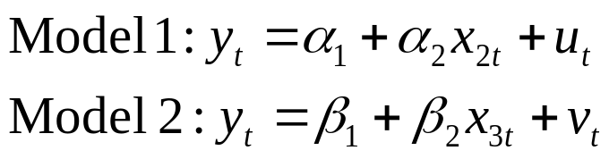

Tests of Non-nested Hypotheses
All of the hypothesis tests concluded thus far have been in the context of “nested” models.
But what if we wanted to compare between the following models?
We could use R² or adjusted R², but what if the number of explanatory variables were different across the 2 models?
An alternative approach is an encompassing test, based on examination of the hybrid model:
‘Introductory Econometrics for Finance’ © Chris Brooks 2019

Slide 30
Tests of Non-nested Hypotheses (cont’d)
There are 4 possible outcomes when Model 3 is estimated:
  γ₂ is significant but γ₃ is not
  γ₃ is significant but γ₂ is not
  γ₂ and γ₃ are both statistically significant
  Neither γ₂ nor γ₃ are significant
Problems with encompassing approach:
  Hybrid model may be meaningless
  Possible high correlation between x₂ and x₃.
‘Introductory Econometrics for Finance’ © Chris Brooks 2019

Slide 31
Quantile Regression - Background
Standard regression approaches effectively model the (conditional) mean of the dependent variable
We could calculate from the fitted regression line the value that y would take for any values of the explanatory variables
But this would be an extrapolation of the behaviour of the relationship between y and x at the mean to the remainder of the data
This approach will often be suboptimal
For example, there might be a non-linear (e.g., ∩-shaped) relationship between x and y
Estimating a standard linear regression model may lead to seriously misleading estimates of this relationship as it will ‘average’ the positive and negative effects.
‘Introductory Econometrics for Finance’ © Chris Brooks 2019

Slide 32
Quantile Regression – Background 2
It would be possible to include non-linear (i.e. polynomial) terms in the regression model (for example, squared, cubic, . . . terms)
But quantile regressions represent a more natural and flexible way to capture the complexities by estimating models for the conditional quantile functions
Quantile regressions can be conducted in both time-series and cross-sectional contexts
It is usually assumed that the dependent variable, often called the response variable, is independently distributed and homoscedastic
Quantile regressions are more robust to outliers and non-normality than OLS regressions
‘Introductory Econometrics for Finance’ © Chris Brooks 2019

Slide 33
Quantile Regression – Background 3
Quantile regression is a non-parametric technique since no distributional assumptions are required to optimally estimate the parameters
The notation and approaches commonly used in quantile regression modelling are different to those that we are familiar with in financial econometrics
Increased interest in modelling the ‘tail behaviour’ of series have spurred applications of quantile regression in finance
A common use of the technique here is to value at risk modelling
This seems natural given that the models are based on estimating the quantile of a distribution of possible losses.
‘Introductory Econometrics for Finance’ © Chris Brooks 2019

Slide 34
Quantiles – A Definition
Quantiles, denoted τ, refer to the position where an observation falls within an ordered series for y, for example:
  The median is the observation in the very middle
  The (lower) tenth percentile is the value that places 10% of observations below it (and therefore 90% of observations above)
More precisely, we can define the τ -th quantile, Q(τ ), of a random variable y having cumulative distribution F(y) as
Q(τ ) = inf y : F(y) ≥ τ
where inf refers to the infimum, or the ‘greatest lower bound’, which is the smallest value of y satisfying the inequality
By definition, quantiles must lie between zero and one
Quantile regressions effectively model the entire conditional distribution of y given the explanatory variables.
‘Introductory Econometrics for Finance’ © Chris Brooks 2019

Slide 35
Estimation of Quantile Functions
The OLS estimator finds the mean value that minimises the RSS and minimising the sum of the absolute values of the residuals will yield the median
The absolute value function is symmetrical so that the median always has the same number of data points above it as below it
If the absolute residuals are weighted differently depending on whether they are positive or negative, we can calculate the quantiles of the distribution
To estimate the τ -th quantile, we would set the weight on positive observations to τ and that on negative observations to 1 − τ
We can select the quantiles of interest and common choices would be 0.05, 0.1, 0.25, 0.5, 0.75, 0.9, 0.95
The fit is not good for values of τ too close to its limits of 0 and 1.
‘Introductory Econometrics for Finance’ © Chris Brooks 2019

Slide 36

Estimation of Quantile Functions 2
We could write the minimisation problem for a set of quantile regression parameters , each element of which is a k × 1 vector, as
As above, for the median, τ = 0.5 and the weights are symmetric but for all other quantiles they will be asymmetric
This optimisation problem can be solved using a linear programming representation via the simplex algorithm or within the generalised method of moments framework.
‘Introductory Econometrics for Finance’ © Chris Brooks 2019

Slide 37
Quantile Regression – How not to do it
As an alternative to quantile regression, it would be tempting to think of partitioning the data and running separate regressions on each of them
  For example, dropping the top 90% of the observations on y and the corresponding data points for the xs, and running a regression on the remainder
However, this process, tantamount to truncating the dependent variable, would be wholly inappropriate
  It could lead to potentially severe sample selection biases
In fact, quantile regression does not partition the data
  All observations are used in the estimation of the parameters for every quantile
‘Introductory Econometrics for Finance’ © Chris Brooks 2019

Slide 38
Quantile Regression Example
A study by Bassett and Chen (2001) performs a style attribution analysis for a mutual fund and, for comparison, the S&P500 index
To examine how a portfolio’s exposure to various styles varies with performance, they use a quantile regression approach
They conduct a style analysis by regressing the returns of a fund on the returns of a large growth portfolio, the returns of a large value portfolio, the returns of a small growth portfolio, and the returns of a small value portfolio
These style portfolio returns are based on the Russell style indices
The parameter estimates on each of these style-mimicking portfolio returns will measure the extent to which the fund is exposed to that style.
‘Introductory Econometrics for Finance’ © Chris Brooks 2019

Slide 39
Quantile Regression Example – Discussion of Results
We can determine the actual investment style of a fund without knowing anything about its holdings purely based on an analysis of its returns ex post and their relationships with the returns of style indices
The results are shown from a standard OLS regression and quintile regressions for τ = 0.1, 0.3, 0.5 (i.e. the median), 0.7, and 0.9
The data are observed over the five years to December 1997 with standard errors based on a bootstrapping procedure
Notice that the sum of the style parameters for a given regression is always one (except for rounding errors)
The OLS results (column 2) show that the mean return has by far its biggest exposure to large value stocks (and this parameter estimate is also statistically significant).
‘Introductory Econometrics for Finance’ © Chris Brooks 2019

Slide 40
Quantile Regression Example –
Discussion of Results 2
Comparing the mean (OLS) results with those for the median, Q(0.5), the latter show much higher exposure to large value, less to small growth and none at all to large growth.
We can examine the factor tilts as we move through the quantiles from left (Q(0.1)) to right (Q(0.9))
  The loading on large growth monotonically falls from 0.31 at Q(0.1) to 0.01 at Q(0.9) while the loadings on large value and small growth substantially increase
  The loading on small value falls from 0.31 at Q(0.1) to -0.51 at Q(0.9)
  It is obvious that the intercept (coefficient on the constant) estimates should be monotonically increasing from left to right since the quantile regression effectively sorts on average performance
  The intercept can be interpreted as the performance expected if the fund had zero exposure to all of the styles.
‘Introductory Econometrics for Finance’ © Chris Brooks 2019

Slide 41
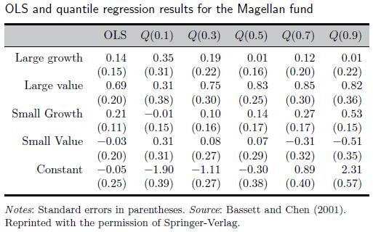
Quantile Regression Example – Table of Results
‘Introductory Econometrics for Finance’ © Chris Brooks 2019

Slide 42
Factor Models and Principal Components Analysis (PCA)
Factor models are employed as dimensionality reduction techniques in situations where we have a large number of closely related variables
They decompose the structure of a set of series into factors that are common and a proportion that is specific to each series (idiosyncratic)
There are two types of such models: economic and mathematical factor models
The key distinction between the two is that the factors are observable for the former but are latent (unobservable) for the latter
Observable factor models include the APT model of Ross (1976)
The most common mathematical model is principal components analysis
PCA may be useful where explanatory variables are closely related – for example, in the context of near multicollinearity.
‘Introductory Econometrics for Finance’ © Chris Brooks 2019

Slide 43

How PCA Works
If there are k explanatory variables in the regression model, PCA will transform them into k uncorrelated new variables
Suppose that the original explanatory variables are denoted x₁, x₂, . . . , x_{k}, and denote the principal components by p₁, p₂, . . . , p_{k}
These principal components are independent linear combinations of the original data:
where α_{ij} are coefficients to be calculated, representing the coefficient on the j^{th} explanatory variable in the i^{th} principal component
These coefficients are factor loadings.
‘Introductory Econometrics for Finance’ © Chris Brooks 2019

Slide 44
PCA – More Details
The sum of the squares of the coefficients for each component will be one
Constructing the components is a purely mathematical exercise in constrained optimisation, and thus no assumption is made concerning the structure, distribution, or other properties of the variables
The principal components are derived in such a way that they are in descending order of importance
Although there are k principal components, if there is some collinearity between the original explanatory variables, it is likely that some of the principal components will account for so little of the variation that they can be discarded.
‘Introductory Econometrics for Finance’ © Chris Brooks 2019

Slide 45

Principal Components as Eigenvalues
The principal components can also be understood as the eigenvalues of (X′X), where X is the matrix of observations on the original variables
If the ordered eigenvalues are denoted λ_{i} (i = 1, . . . , k), the ratio:
gives the proportion of the total variation in the original data explained by the principal component i
If only the first r (0 < r < k) principal components are useful in explaining the variation of (X′X) and are retained, the remaining k−r components would be discarded.
‘Introductory Econometrics for Finance’ © Chris Brooks 2019

Slide 46
Principal Components as Eigenvalues
The regression finally estimated, after the principal components have been formed, would be one of y on the first r principal components:
y_{t} = γ₀ + γ₁p_{1t} + · · · + γ_{r}p_{rt} + u_{t}
In this way, the principal components are argued to keep most of the important information contained in the original explanatory variables, but are orthogonal
The principal component estimates from this regression will be biased, although they will be more efficient than the OLS ones since redundant information has been removed
The principal component coefficient estimates will simply be linear combinations of the original OLS estimates.
‘Introductory Econometrics for Finance’ © Chris Brooks 2019

Slide 47
PCA Example: An Application to Interest Rates
Researchers may wish to include interest rates on a large number of different assets in order to reflect the variety of investment opportunities open to investors
However, market interest rates are likely to be highly correlated
One approach would be to use PCA on several related interest rate series to determine whether they are actually closely related or not
Fase (1973) conducted a study of monthly Dutch market interest rates from January 1962 until December 1970 (108 months)
The money market instruments investigated were:
  Call money, 3-month Treasury paper, 1-year T-paper, 2-year T-paper, 3-year T-paper, 5-year T-paper, 3-month loans to local authorities, 1-year loans to local authorities, Eurodollar deposits, Netherlands Bank official discount rate.
‘Introductory Econometrics for Finance’ © Chris Brooks 2019

Slide 48
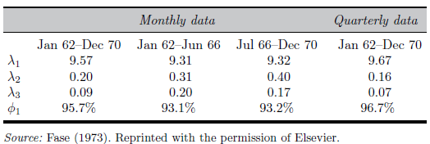
PCA Example: The Principal Components
Prior to analysis, each series was standardised to have zero mean and unit variance
The three largest of the ten eigenvalues are given in the following table
The first principal component is sufficient to describe the common variation in these Dutch interest rates
The 1st component is able to explain over 90% of the variation for all samples
‘Introductory Econometrics for Finance’ © Chris Brooks 2019

Slide 49
PCA Example: The Factor Loadings
The factor loadings (coefficient estimates) for the first two ordered components are given in the table below
The loadings on each factor making up the first principal component are all positive
Since each series has been standardised, the coefficients α_{j1} and α_{j2} can be interpreted as the correlations between the interest rate j and the first and second principal components, respectively
The factor loadings for each interest rate series on the first component are all very close to one
Fase (1973) therefore argues that the first component can be interpreted simply as an equally weighted combination of all of the market interest rates.
‘Introductory Econometrics for Finance’ © Chris Brooks 2019

Slide 50
PCA Example: The Factor Loadings 2
The second component, which explains much less of the variability of the rates, shows a factor loading pattern of positive coefficients for the Treasury paper series and negative or almost zero values for the other series
Fase (1973) argues that this is owing to the characteristics of the Dutch Treasury instruments that they rarely change hands and have low transactions costs, and therefore have less sensitivity to general interest rate movements
Also, they are not subject to default risks in the same way as, for example, Eurodollar deposits
Therefore, the second principal component is broadly interpreted as relating to default risk and transactions costs.
‘Introductory Econometrics for Finance’ © Chris Brooks 2019

Slide 51
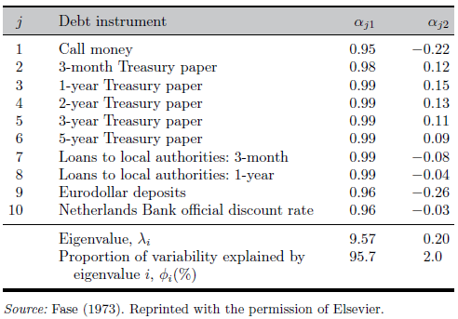
PCA Example: The Factor Loadings Presented
‘Introductory Econometrics for Finance’ © Chris Brooks 2019

Slide 52
Limitations of PCA
A change in the units of measurement of x will change the principal components
It is thus usual to transform all of the variables to have zero mean and unit variance prior to applying PCA
The principal components usually have no theoretical motivation or interpretation whatsoever
The r principal components retained from the original k are the ones that explain most of the variation in x, but these components might not be the most useful as explanations for y.
‘Introductory Econometrics for Finance’ © Chris Brooks 2019

